Slide 1

MACHINE LEARNING PROJECT
MOVIE RECOMMENDATION SYSTEM

Slide 2

TEAM MEMBERS
Yash Kr. Singh(Team Leader)
Prabhat Kr. Singh
Sarvendra Kr. Singh
Sanal Mishra

Slide 3

WHAT IS THIS PROJECT?
Recommender System is a system that seeks to predict or filter preferences according to the user’s choices. Recommender systems are utilized in a variety of areas including movies, music, news, books, research articles, search queries, social tags, and products in general.

Slide 4
DEPENDENCIES
Python >=3.5
pandas
numpy
scipy
scikit-learn
matplotlib
GIT
Github

Slide 5

WHY GIT & GITHUB?
Git is a version control system that lets you manage and keep track of your source code history.
GitHub is a cloud-based hosting service that lets you manage Git repositories. If you have open-source projects that use Git, then GitHub is designed to help you better manage them.

Slide 6

WHAT IS TK-INTER?
Python offers multiple options for developing GUI (Graphical User Interface).Out of all the GUI methods, tkinter is the most commonly used method.It is a standard Python interface to the Tk GUI toolkit shipped with Python. Python with tkinter is the fastest and easiest way to create the GUI applications.Creating a GUI using tkinter is an easy task.

Slide 7
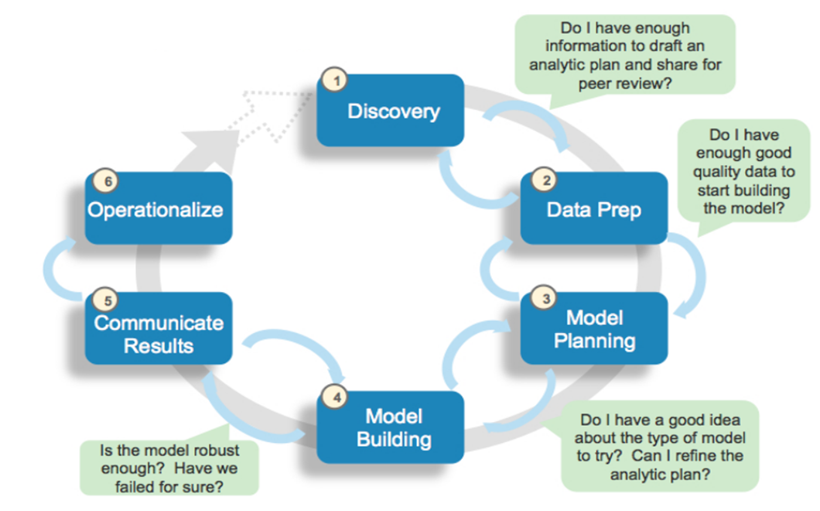
DATA ANALYTICS LIFECYCLE

Slide 8

Building a Recommendation Engine With Collaborative Filtering

Slide 9
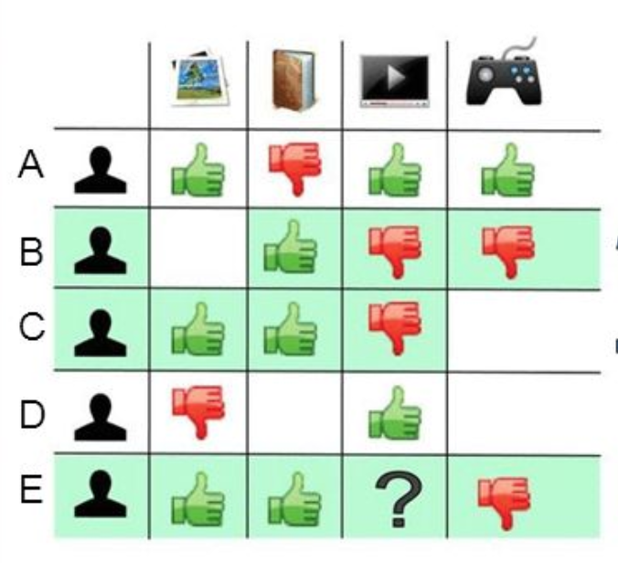
COLLABORATIVE FILTERING
Collaborative filtering is a family of algorithms where there are multiple ways to find similar users or items and multiple ways to calculate rating based on ratings of similar users. Depending on the choices you make, you end up with a type of collaborative filtering approach.

Slide 10

DATASET DESCRIPTION
movies.csv
ratings.csv
ratings_small.csv
movies_small.csv

Slide 11

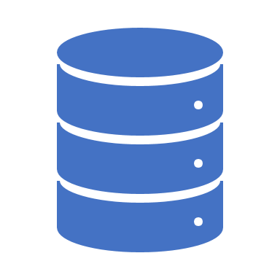
DETAILS ABOUT DATASET
We have used MovieLens dataset in order to build a movie recommendation engine. Types of dataset:-
The full dataset: This dataset consists of 26,000,000 ratings and 750,000 tag applications applied to 45,000 movies by 270,000 users. Includes tag genome data with 12 million relevance scores across 1,100 tags.
The small dataset: This dataset comprises of 100,000 ratings and 1,300 tag applications applied to 9,000 movies by 700 users.

Slide 12
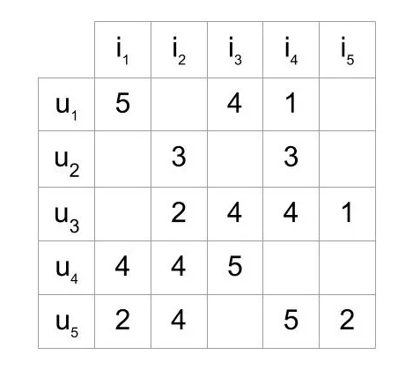
MATRIX EXPLANATION
To experiment with recommendation algorithms, you’ll need data that contains a set of items and a set of users who have reacted to some of the items.
The reaction can be explicit (rating on a scale of 1 to 5, likes or dislikes) or implicit (viewing an item, adding it to a wish list, the time spent on an article).
While working with such data, you’ll mostly see it in the form of a matrix consisting of the reactions given by a set of users to some items from a set of items. Each row would contain the ratings given by a user, and each column would contain the ratings received by an item. A matrix with five users and five items could look like this:

Slide 13
DATA EXPLORATION
Data exploration is the first step in data analysis and typically involves summarizing the main characteristics of a data set, including its size, accuracy, initial patterns in the data and other attributes.
Before it can conduct analysis on data collected by multiple data sources and stored in data warehouses, an organization must know how many cases are in a data set, what variables are included, how many missing values there are and what general hypotheses the data is likely to support. An initial exploration of the data set can help answer these questions by familiarizing analysts with the data with which they are working.

Slide 14
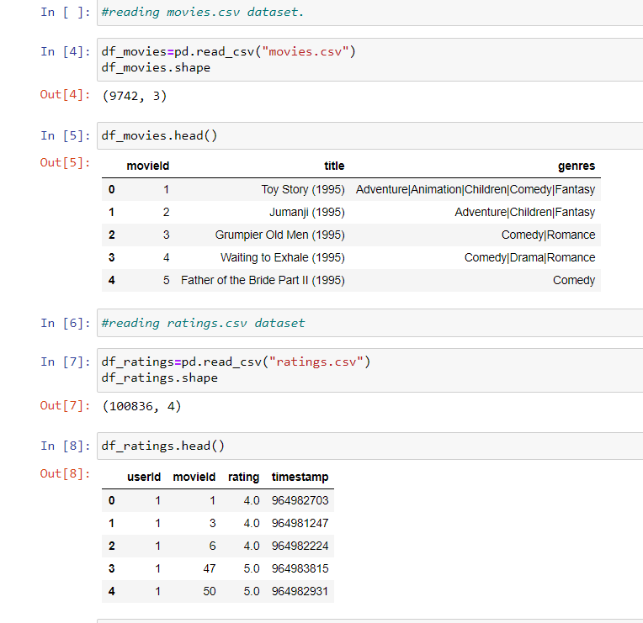
RELATED WORK
After reading the datasets(movies.csv and ratings.csv) we found out the total number of rows and columns present in it and then we got the top five rows of both the datasets.

Slide 15
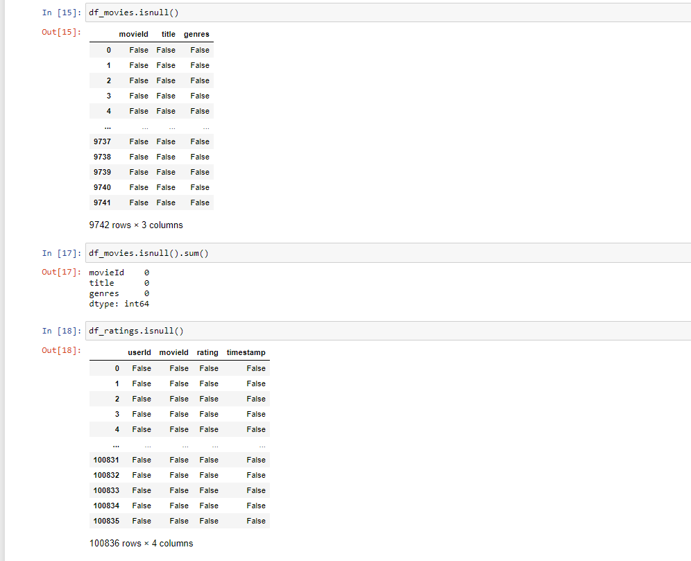
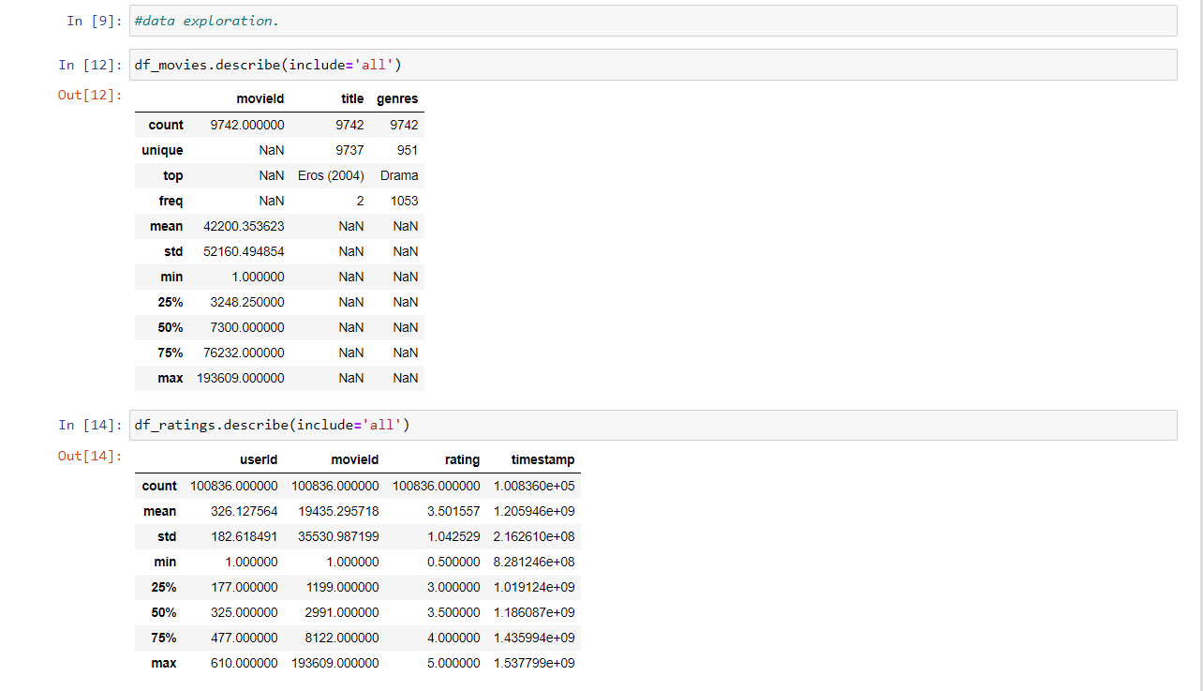
DATA EXPLORATION

Slide 16
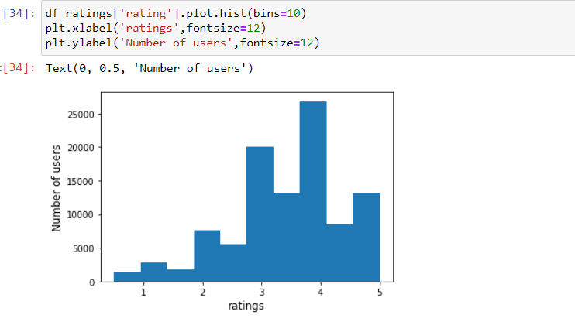
TO BE DONE
After completing the previous steps we plotted the histogram in order to get the idea of the frequency distribution of the ratings given by different users.

Slide 17
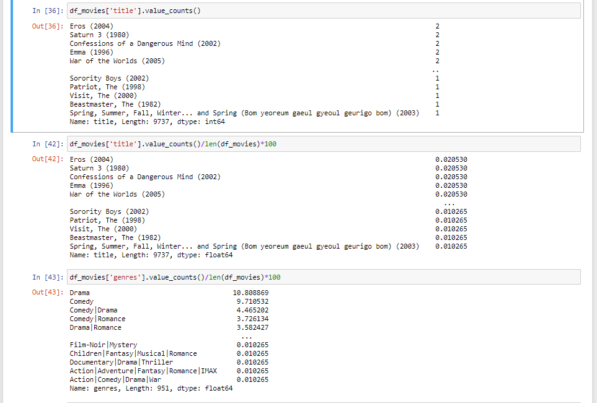
TO BE DONE
One of our task was to find the number of movies and genres in the dataset. After that we found out each of their distribution on the dataset.

Slide 18
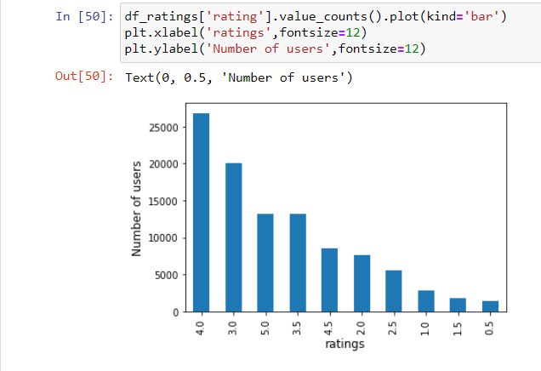
TO BE DONE
To get a clear view of the ratings that each user has given to movies we plotted a bar graph.

Slide 19
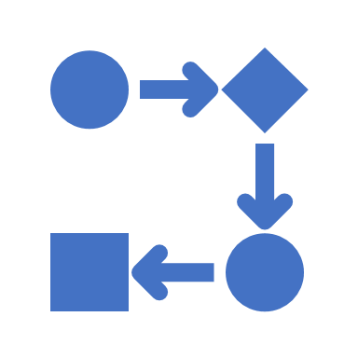
MODEL PLANNING
Model planning is phase 3 of lifecycle phases of data analytics, where team determines methods, techniques, and workflow it intends to follow for subsequent model building phase

Slide 20
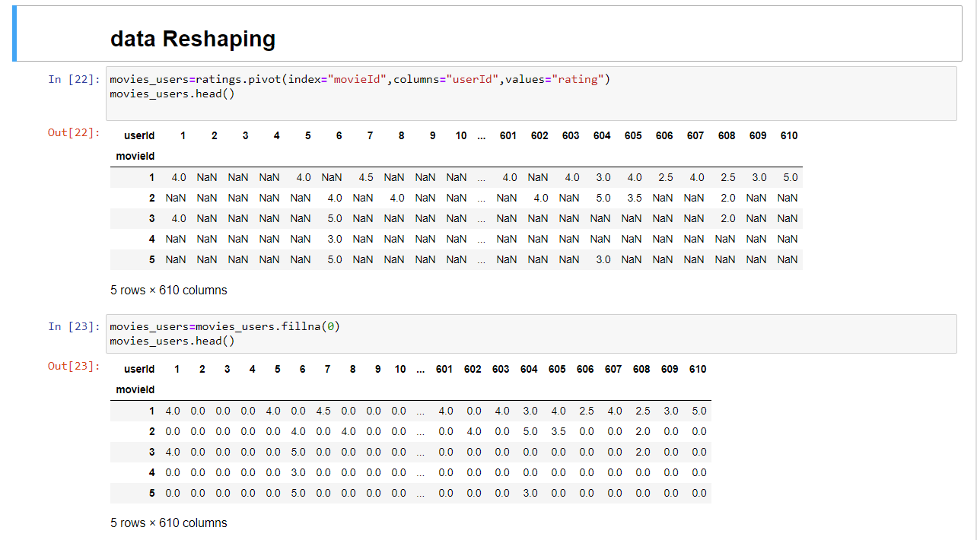
RESHAPING
Set up the environment and load the data
Investigate the data
Parse the different data tabs
Standardize existing columns and create new ones
Reshape the data from wide to long by pivoting on multi-level indices and stacking

Slide 21
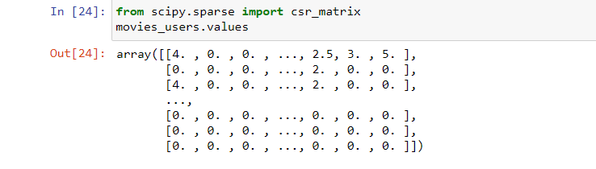
COVERTING DATAFRAME OF MOVIE FEATURES TO SCIPY SPARSE MATRIX
MODELLING

Slide 22
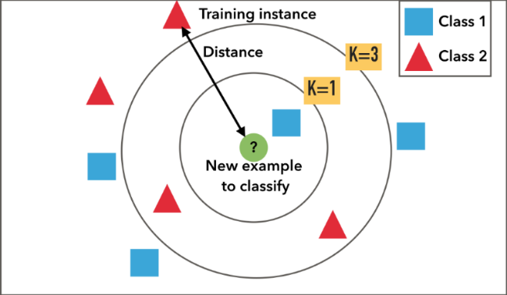
K-NN MODEL
To implement collaborative filtering, KNN is a perfect go-to model and also a very good baseline for recommender system development. But what is the KNN? KNN is a non-parametric, lazy learning method. It uses a database in which the data points are separated into several clusters to make inference for new samples.
KNN does not make any assumptions on the underlying data distribution but it relies on item feature similarity. When KNN makes inference about a movie, KNN will calculate the “distance” between the target movie and every other movie in its database, then it ranks its distances and returns the top K nearest neighbor movies as the most similar movie recommendations.

Slide 23
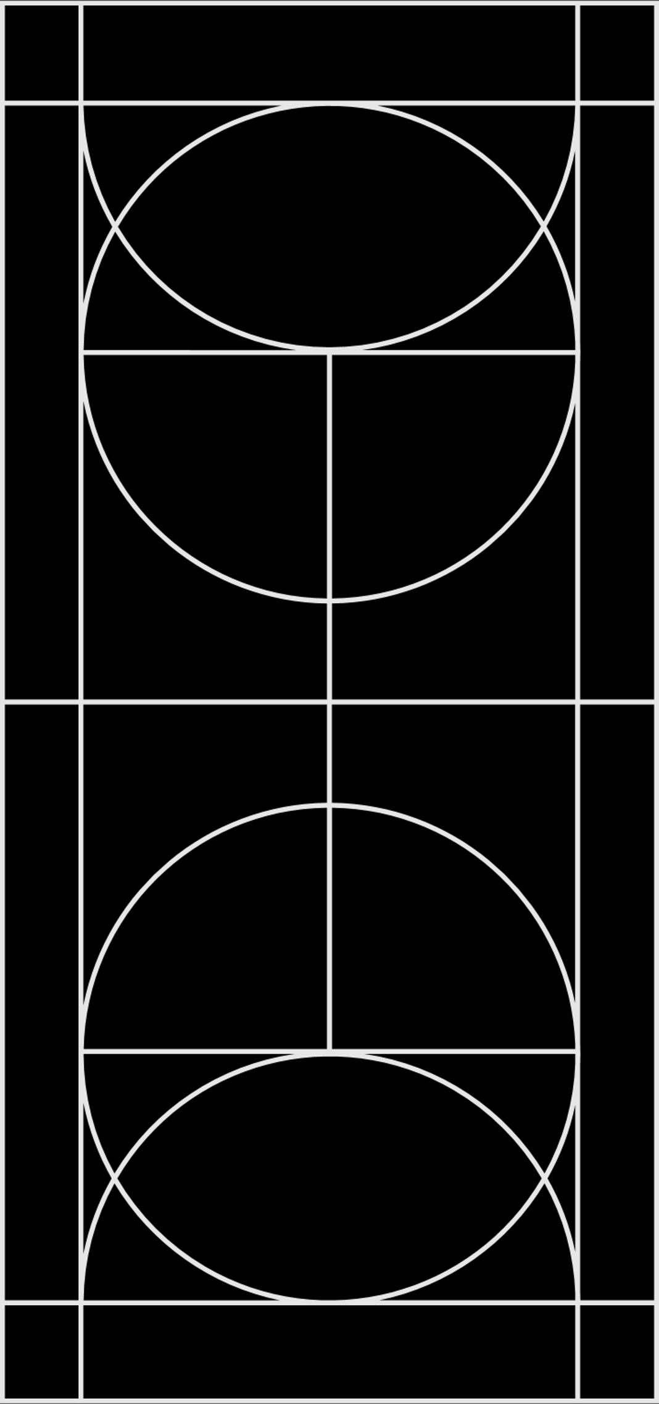
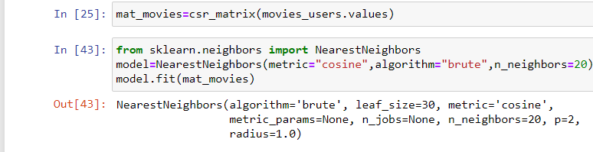
IMPLEMENTING K-NN

Slide 24
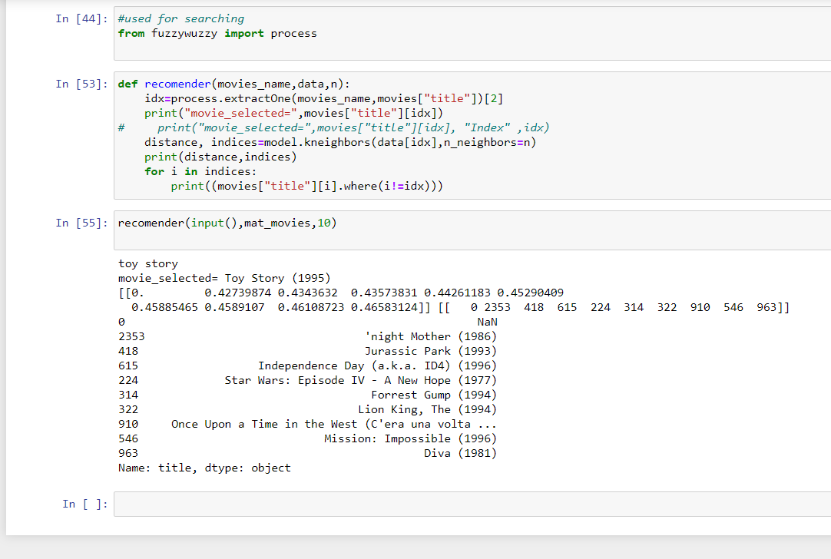
TO BE DONE

Slide 25

TKinter Module
In this project we have also included tkinter in order to create a user interface so that the user can easily select among the recommended movies.

Slide 26
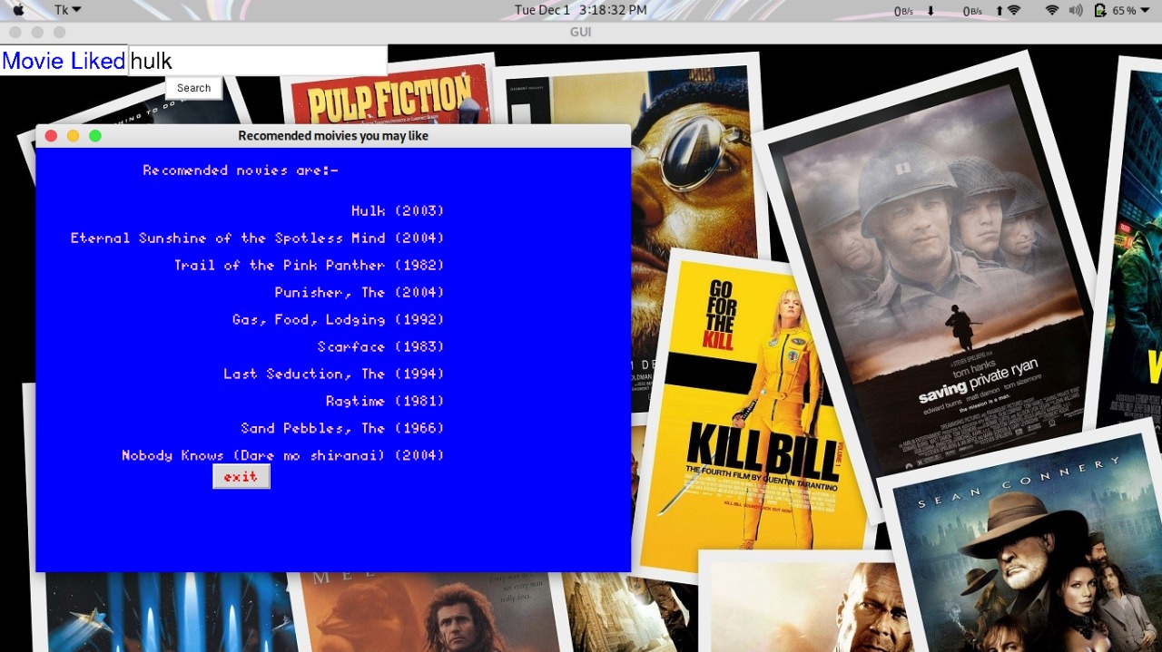
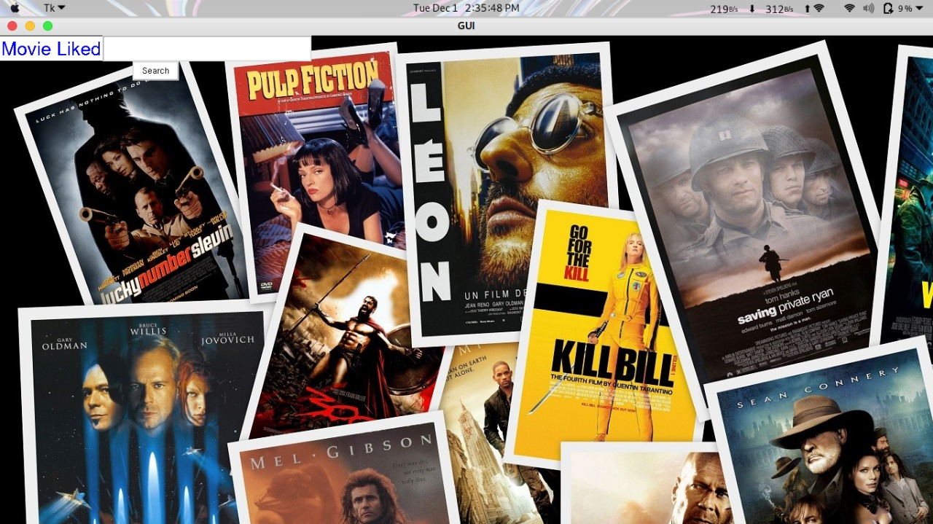
Related Screenshots

Slide 27


